Slide 1




Easy Housing Solution
by Group 3

Slide 2




Meet the Team
Shashank Bhake
Aarushi Goyal
Veera Vardhan Addala
Om Gupta
Nishant Dhupia
Sai Shanmukh Kundam
Nikhil Pratap Singh Rathore

Slide 3




Problem Statement
Easy Housing Solution (EHS) is an online platform for buying, selling, and renting properties, where users can manage listings, upload images, and get them verified for a seamless experience.
BUYERS' NEEDS
Buyers require easy access to listings and tools for comparing properties.
SELLERS' NEEDS
Sellers need a streamlined process for listing properties and managing inquiries.
ADMIN FEATURES
Admins must ensure smooth operations and maintain user data security.

Slide 4

Benefits Overview
Convenience
Access property listings, comparisons, and management anytime, anywhere.
Streamlined Process
One platform for buying, selling, renting, and maintaining property details.
Property Management
Owners can easily upload images and update property information, view their listed properties
Time-Saving
Skip the hassle of manual searches and in-person inquiries with online listings.

Slide 5



Technologies Used
ASP.NET Core MVC: For building flexible & high-performance web apps.
Entity Framework Core: Facilitating seamless data access & management.
Azure Web App: Hosting web apps.
Azure Blob Storage: Securely storing media assets.
Azure SQL Database: Providing a Relational DBMS.
Azure Logic App & Azure Functions: Automating workflows and enabling serverless functions.

Slide 6



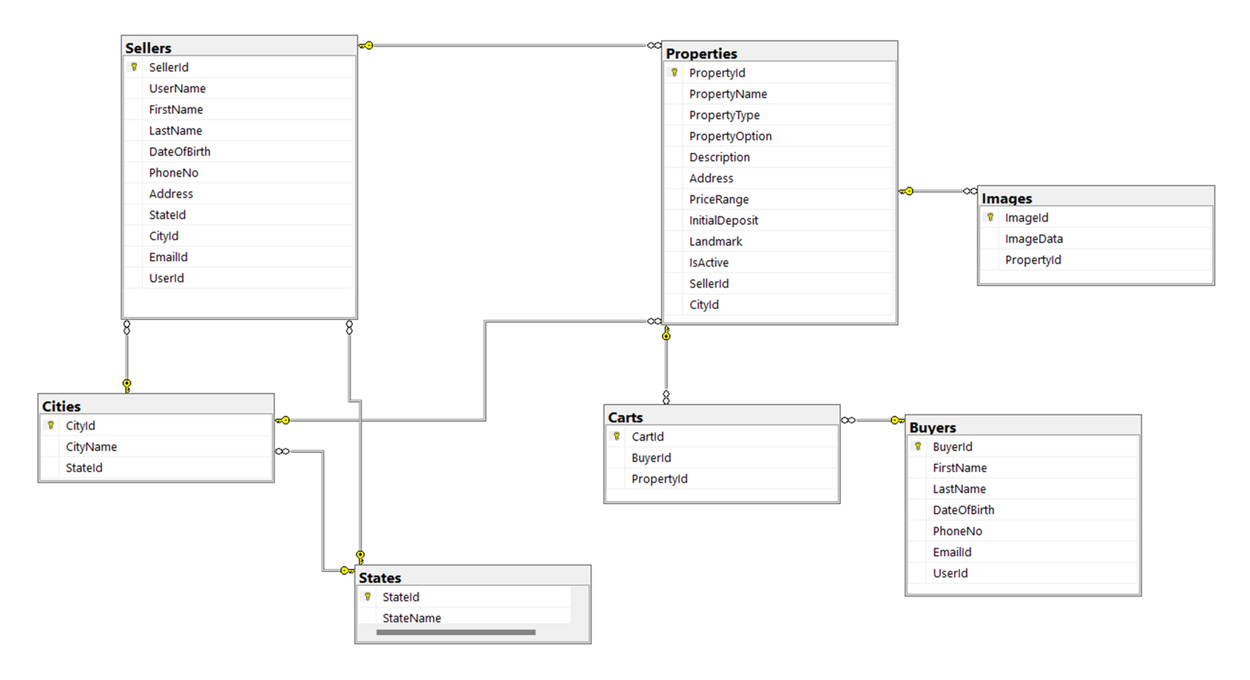

Entity-Relation
Understanding the structure and relationships of our data model

Slide 7



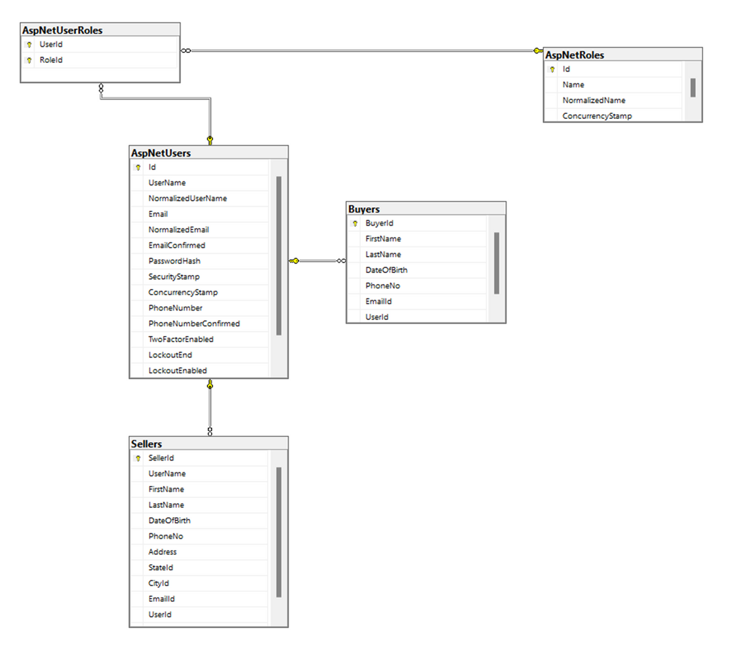
Entity-Relation

Slide 8

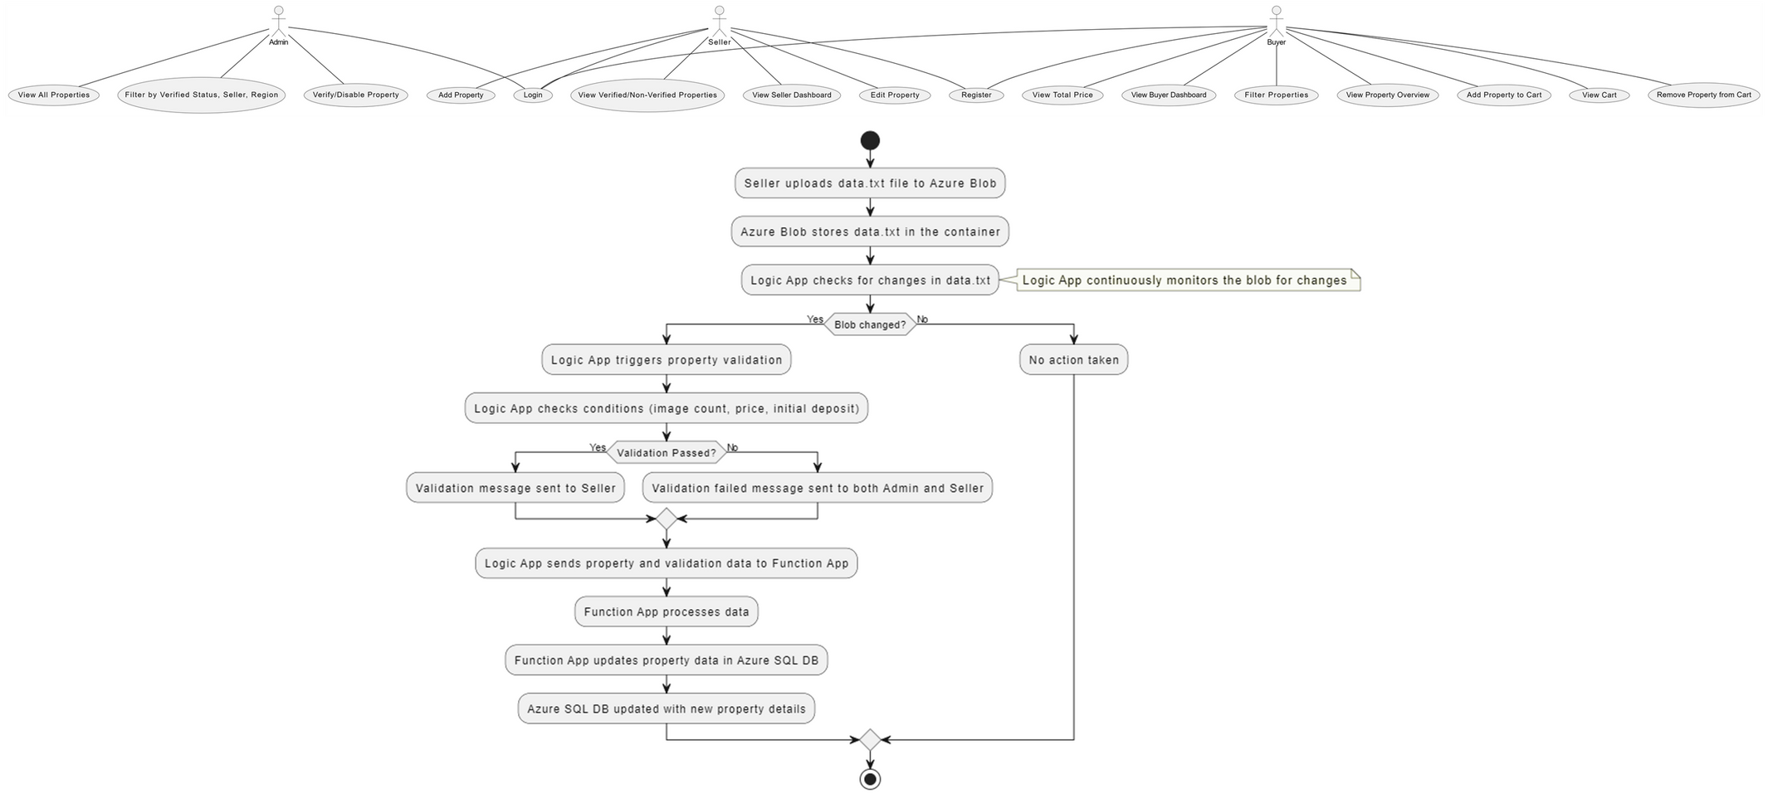
Architecture

Slide 9




Key Features
Role based access to the web app
Add, edit and view properties
Filter properties based on different parameters
Add and delete properties to cart
View cart items
Can validate or invalidate a property

Slide 10
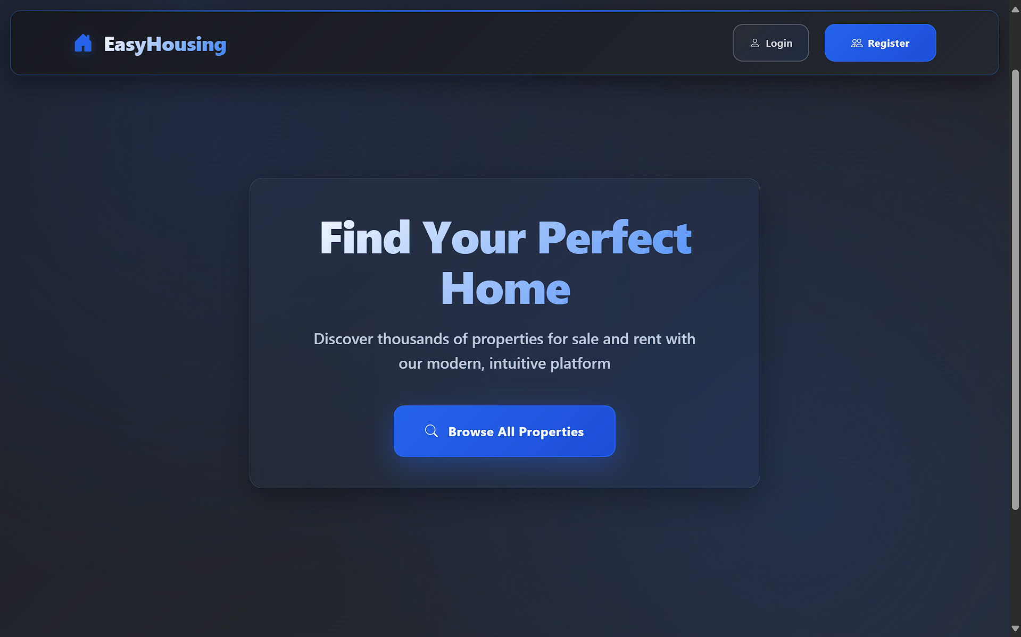

Web App Homepage

Slide 11

Future Scope
Adding government-issued document validation for buyer, seller and properties
Geo-location tagging for properties
Chat functionality between buyers and sellers
Compare property details
Adding a payment gateway for cart
Deleting properties and accounts

Slide 12



Thank You!
Visit us at our web application for more information.
WEB APPLICATION URL:
https://ezhousinginstance-a0gyh3f3ceb9dec7.eastus2-01.azurewebsites.net/

